Slide 1
Clinically Significant Information Extraction from Radiology Reports
Author: Nidhin Nandhakumar, Ehsan Sherkat,
Evangelos E. Milios, Hong Gu ,Michael Butler
Sourse: DocEng '17 (Document Engineering '17)
Advisor: Jia-Ling Koh
Speaker: BOWEN CHIANG
Date: 2017/10/24

Slide 2
Outline
Introduction
Method
Experiment
Conclusion

Slide 3
Introduction
Motivation
Radiology reports provide the emergency physicians with critical information regarding the condition of the patient and help the physicians take immediate action on urgent conditions.
However, the reports are in the form of unstructured text, which makes them time consuming for humans to interpret.

Slide 4
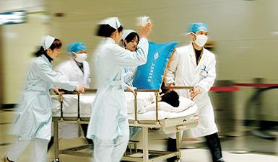
Introduction
Purpose
Developed a machine learning system to
(a) efficiently extract the clinically significant parts and their level of importance in radiology reports
(b) to classifies the overall report into critical or non-critical categories which help doctors to identify potential high priority reports.

Slide 5
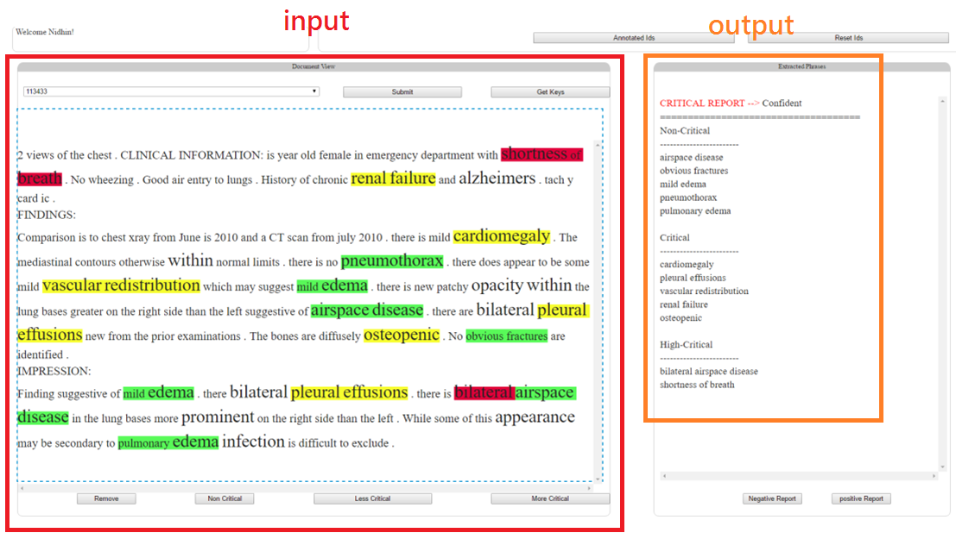
Introduction

Slide 6
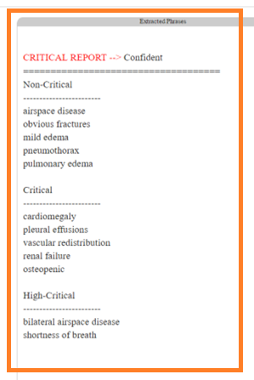
Introduction
Definition
Phrases (Important information) ex: ‘shortness of breath’ 呼吸急促
Critical level
Phrases: high-critical, critical , non-critical, (other)
Radiology reports: critical , non-critical

Slide 7
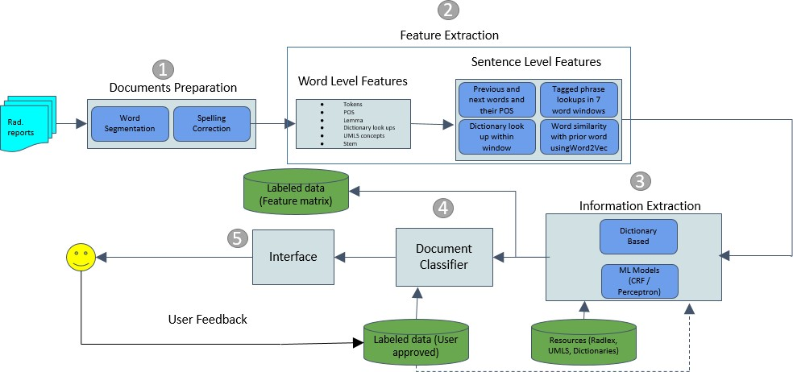
Overall view

Slide 8
Outline
Introduction
Method
Experiment
Conclusion

Slide 9
Method
Resources
We created a dictionary of unigrams and bigrams from the radiology dataset. Based on Radlex and UMLS ontologies, we extracted the medical and radiological terms from this dictionary. We also attached these terms with first 333,000 and 250,000 frequent unigrams and bigrams of Google trillion corpus.
Radlex and UMLS dictionaries which we created from the Radlex ontology and the UMLS ontology

Slide 10
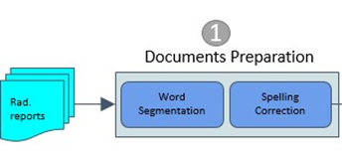
Method
Documents preparation
a) the word segmentation module.
ex: 肋膜積水(Pleural effusion)
b) the spelling correction module.
ex: Pleural effusionn => Pleural effusion

Slide 11
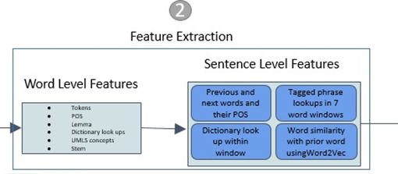
Method
Features
Word level
Stem and lemma of the word:
Stem ex: tall, taller, tallest => tall ;
lemma ex: run, runs, ran , running => run
Part of speech
Word length
Anatomy: a boolean flag value
Suffix and prefix:
Critical level flags:
Meta Label and Meta concept:
Ex: label: 腎臟病 concept:腎結石
Filter words: boolean flag feature

Slide 12
Method
Features
Sentence level
Previous and next word Part of Speech tags
Next Negative and next positive words:
Previous and next negative word positions relative to the current word:
Word similarity
Aggressive and Anatomy descriptors: boolean flags
ex: 腫瘤
High-flag, crit-flag, and non-crit flags: boolean flags

Slide 13
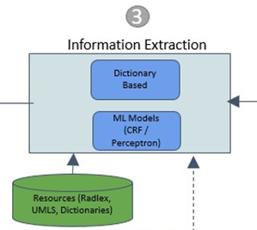
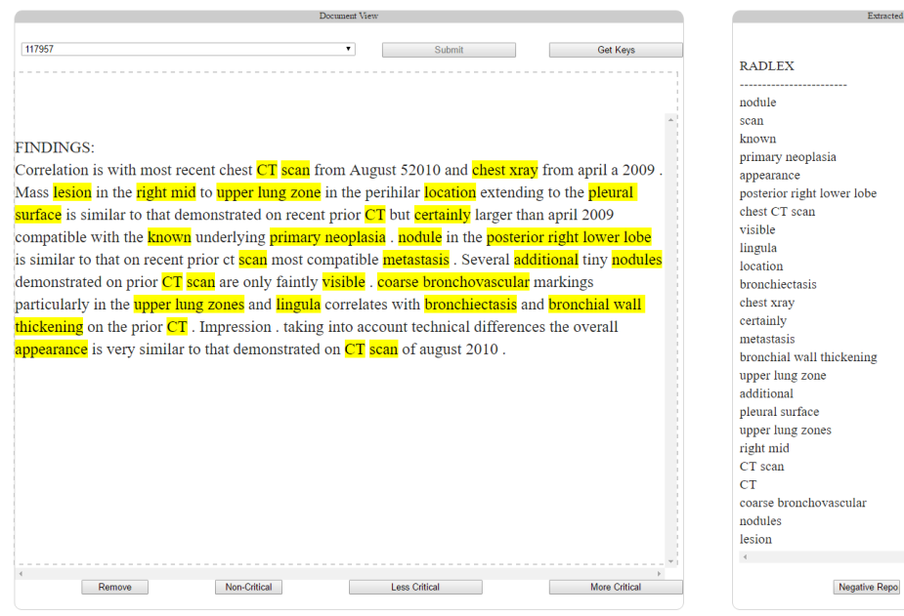
Method
Information extraction
Dictionary base
uses the Radlex
a dictionary search-based model and cannot be used to identify the type of the phrase
(For example, high-critical)

Slide 14
Method
Information extraction
Machine learning model
CRF model (Conditional Random field)
Structured Perceptron model
(input) Use the same features: word level and sentence level
sequence labels:
ex: ‘shortness of breath’ is labeled as B-HIGHCRIT I-HIGHCRIT I-HIGHCRIT
the models are trained to classify the phrases into three separate classes
(output) Document Matrix :
vector for each of the patient reports where the columns represent the unique phrases extracted from all reports.
each phrases : high-critical +1, critical +0.5, non-critical -1

Slide 15
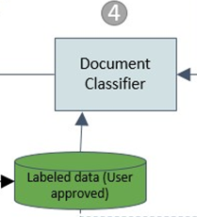
Method
Document Classifier
classifying the radiology report into two classes critical or non-critical reports
Random Forest
Linear SVM models
SGD (Stochastic Gradient descent form the Sklearn library)

Slide 16
Method
Interface

Slide 17
Outline
Introduction
Method
Experiment
Conclusion

Slide 18
Experiment
Feature Analysis
Results for the Machine Learning model
Document Classification

Slide 19
Experiment
Feature Analysis
Table 3: Precision, Recall and f1 scores for CRF model based on various features used during training process.

Slide 20
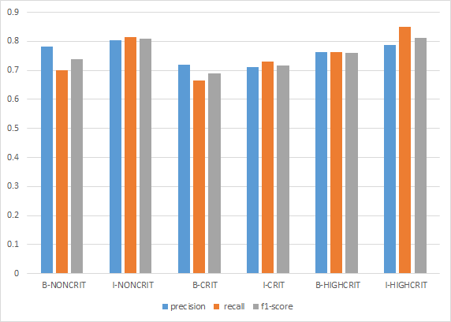
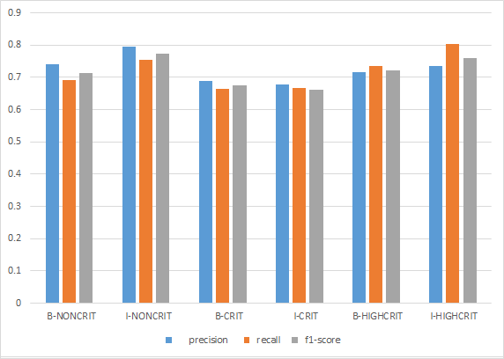
Experiment
Results for the Machine Learning model
Figure 4: the CRF model for each of the different criticality level of extracted phrases.
Figure 5: the Structured Perceptron model for each of the different criticality level phrases extracted

Slide 21
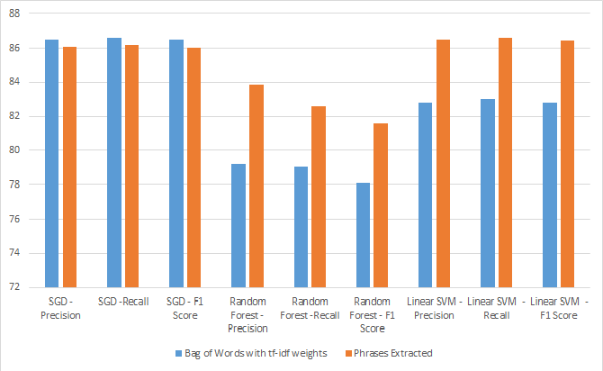
Experiment
Document Classification
Figure 6: Report classification results comparison using ‘bag of words’ having tf-idf weight as features and phrases extracted by the CRF model.

Slide 22
Outline
Introduction
Method
Experiment
Conclusion

Slide 23
Conclusion
The design of a novel system which identifies the medical phrases and their associated criticality values and presents this information in a visual interface.
Designing a novel binary classification system for extracting radiology reports of critical-condition patients.
We have managed to use a novel list of features for be1er classification of the radiology reports.

